Slide 1



roseline-wahome.click
Complaints Text Analysis
Presentation

Slide 2



roseline-wahome.click
Problem Statement
Customer complaints often contain unstructured text, which makes it challenging for companies to efficiently process and act upon the feedback. Without automated methods to recognize key entities such as product names, locations, and complaint categories, valuable insights may go unnoticed.
This project aims to address these challenges by applying Named Entity Recognition (NER) to extract key entities and text summarization to condense the complaint data, facilitating faster and more effective responses to customer concerns.

Slide 3

roseline-wahome.click
Objectives
Improved customer experience
Prioritization
Operational efficiency
Trend analysis

Slide 4

roseline-wahome.click
Methodology
Text Analysis
Text Preprocessing
Named Entities Extraction
Summarization
Named Entities Extraction
Model Tuning
Model Evaluation

Slide 5

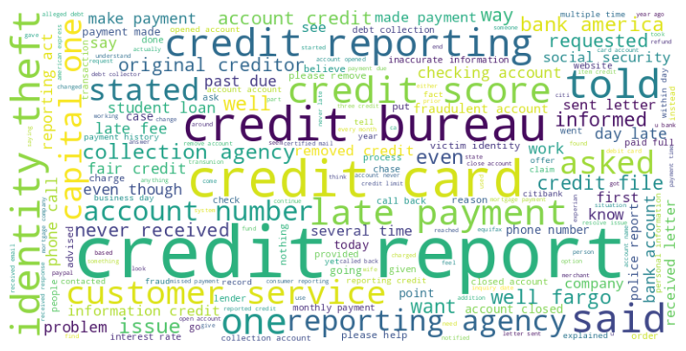
roseline-wahome.click
Data Overview

Slide 6
roseline-wahome.click
Analysis
Credit is one of the most frequently mentioned words from the customers complaints
Different aspects of credit such as reporting, bureau, credit cards all with different levels of intensity.
Credit limit, business days are among the least mentioned words in the complaints.

Slide 7
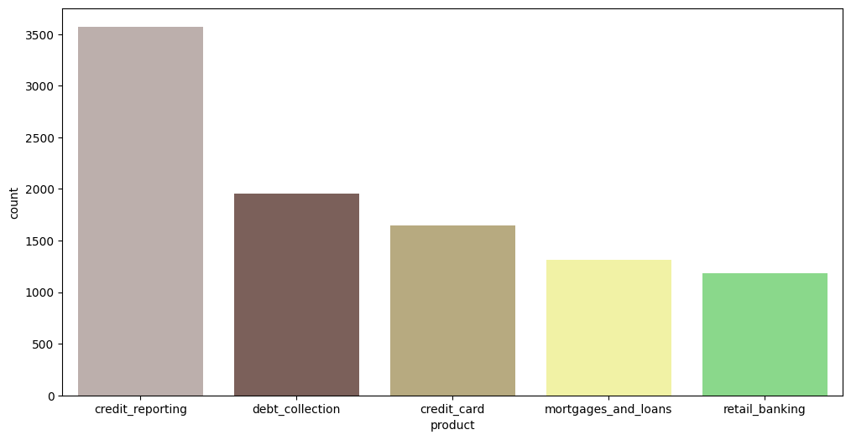
roseline-wahome.click
Product Analysis

Slide 8
roseline-wahome.click
Analysis
Credit reporting was the most frequently mentioned product.
Credit card complaints were mentioned averagely.
Retail banking mentions were the least.

Slide 9
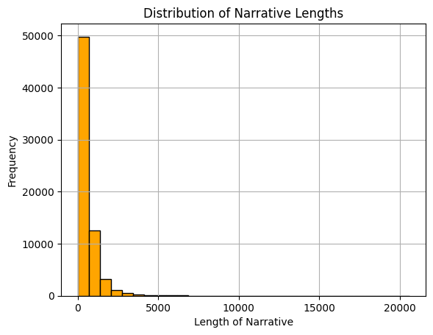
roseline-wahome.click
Narrative Length

Slide 10
roseline-wahome.click
Analysis
Most of the narratives, a frequency of 5000 were within a length of 0-200 words.
About 5000 narratives had words of length greater than 300 but less than 500 words.
Very few narratives, about 100 had a length of more than 500 words.

Slide 11

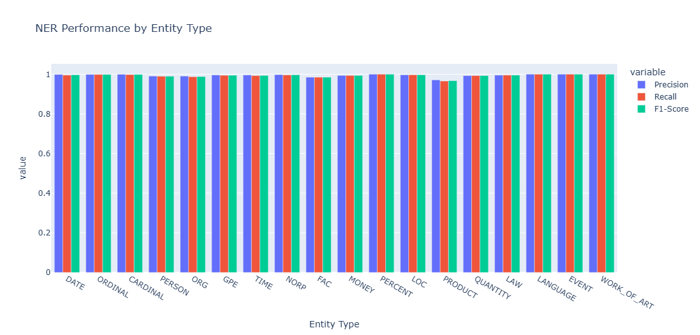
roseline-wahome.click
Key Insights

Slide 12
roseline-wahome.click
Key Insights
The entity “Date” is easily and accurately captured with a precision of 99.8993%.
Entity “Product” is not easily and accurately captured with a precision of 97.1624%
All other entities are well captured with acceptable precision and accuracy.

Slide 13

roseline-wahome.click
Recommendations
Incorporate into business process for compliance monitoring and operational efficiency.
Highlight business impact by capturing data driven insights and time saving from manual text analysis.
Integrate with existing systems such as CRM tools to identify key customer details, knowledge bases to enhance document tagging.

Slide 14

roseline-wahome.click
Next Steps
Enhanced Insights to detect recurring complaint patterns.
Advanced automation for predictive analysis for early fraud detection.
Deployment into a real time API for seamless integration.

Slide 15

roseline-wahome.click
THANK
YOU
-

